Slide 1
Team Collaboration
WP2 T3

Slide 2



Learning Objectives
Understand the need for GitHub organizations when collaborating with others
Differentiate between organization level and repository level permissions
Use the GitHub web portal to add collaborators

Slide 3
Agenda
Creating an Organization
Repository Forking
Adding Collaborators

Slide 4

Introduction
Focus on collaboration options
Most aspects already discussed in previous learning units
Central point for future reference
All initial steps completed by a single person
Organization creation
Forking
Adding collaborators
Image by Larisa Koshkina from Pixabay

Slide 5
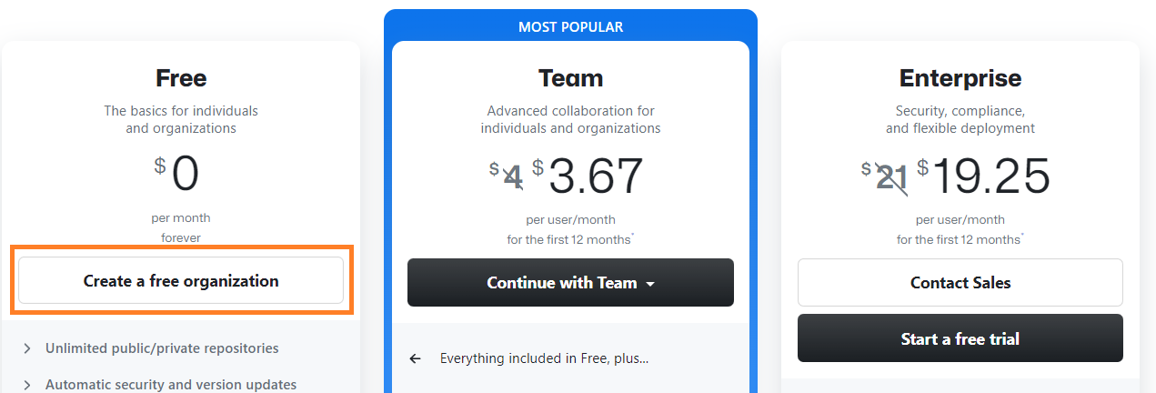
Creating a New Organization
Organization = a logical grouping of multiple repositories
Organization level permissions
Repository level permissions
Steps:
Profile Picture -> Your Organizations -> New Organization
Free plan is equivalent to the Team plan for public repositories

Slide 6

Adding Collaborators
At a repository level
The organization has multiple repositories
Each repository is independent, with distinct collaborators
Collaborators are added at the repository level, as to avoid granting them unnecessary permissions on other, unrelated, repositories
At an organization level
The organization has multiple repositories
Each repository should have the same collaborators as the other ones
Collaborators are added at the organization level. Permissions are automatically propagated to all existing and future repositories
Image by Alexa from Pixabay

Slide 7
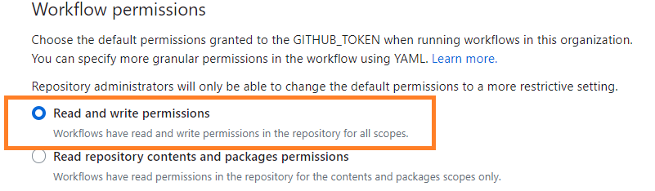
Organization Configuration
After creating the organization, the user is redirected to its homepage
First Step: Add organization level collaborators (if needed)
People tab -> Invite member
Second Step: Ensure proper workflow permissions
Settings tab -> Actions -> General -> Workflow Permissions -> Read and Write Permissions

Slide 8
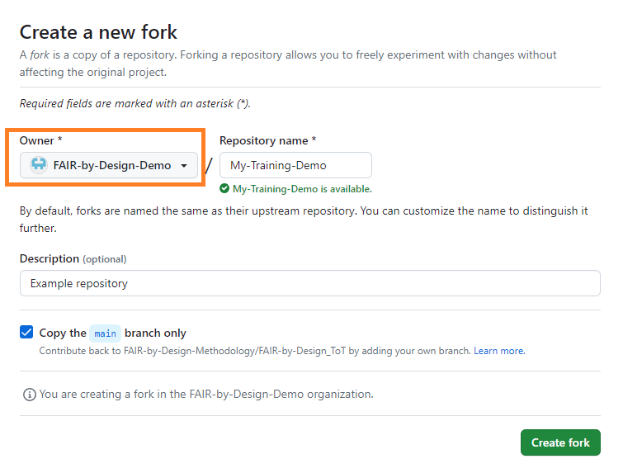
Forking the Templates Repository
Creating a copy of the FAIR-by-Design templates repository by forking it
Fork button (top right corner)
Forking wizard
Repository name: (up to the user)
Owner: the newly created organization
Description: (optional)

Slide 9
Adding Repository Level Collaborators
Navigate to the forked repository’s homepage
Automatic redirect from the forking wizard
Settings -> Collaborators and Teams -> Add people
Search by either email address or GitHub username
Email notification send to invited people
Suggestion: divide work tasks among all the collaborators, avoiding editing conflicts
Advanced: Instructions on how to resolve a Git conflict

Slide 10
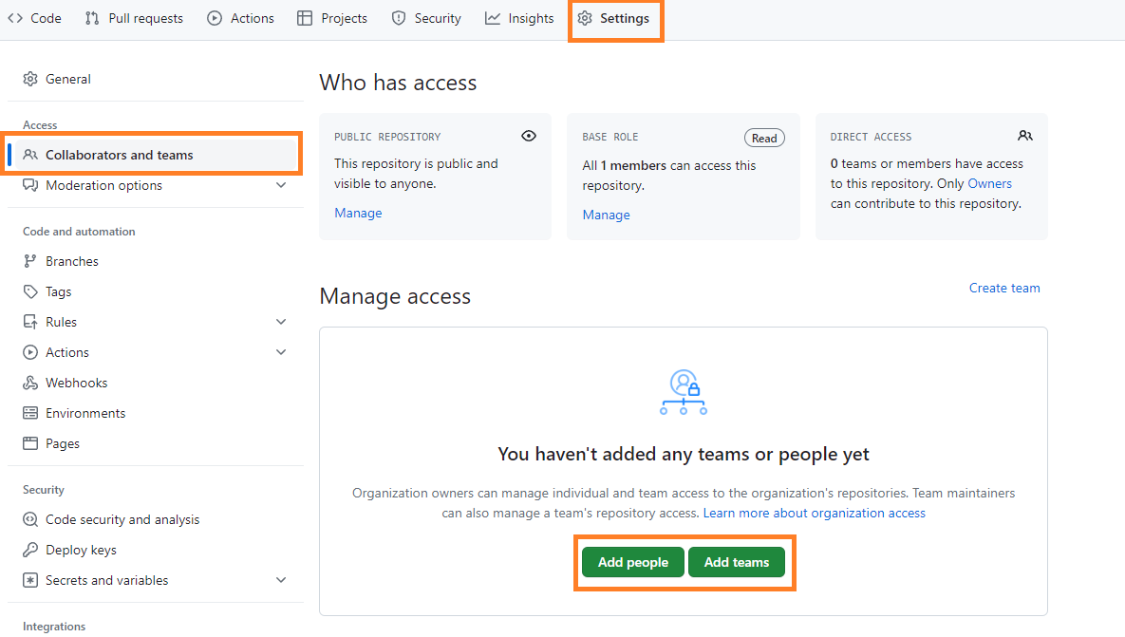
Adding Repository Level Collaborators (cont.)

Slide 11
Thank you! Any questions before we continue?
vojdan.kjorveziroski@finki.ukim.mk
Cite instructions on: https://doi.org/10.5281/zenodo.10014781

